Slide 1
Software Requirements Verification and Validation
Lecturer: Ngo Huy Bien
Software Engineering Department
Faculty of Information Technology
University of Science
Ho Chi Minh City, Vietnam
nhbien@fit.hcmus.edu.vn

Slide 2
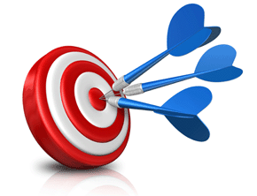
Objectives
To verify a requirement.
To validate a requirement.

Slide 3

Contents

Slide 4

References
Suzanne Robertson and James Robertson (2012). Mastering the Requirements Process. Addison Wesley Professional.

Slide 5
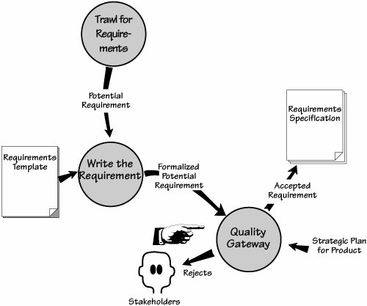
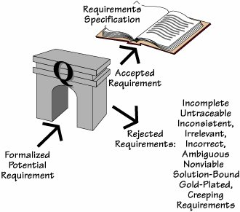
The Quality Gateway [1]
The Quality Gateway tests each requirement for correctness and suitability.
Accepted requirements are added to the specification.
Rejected requirements are returned to their originator.

Slide 6
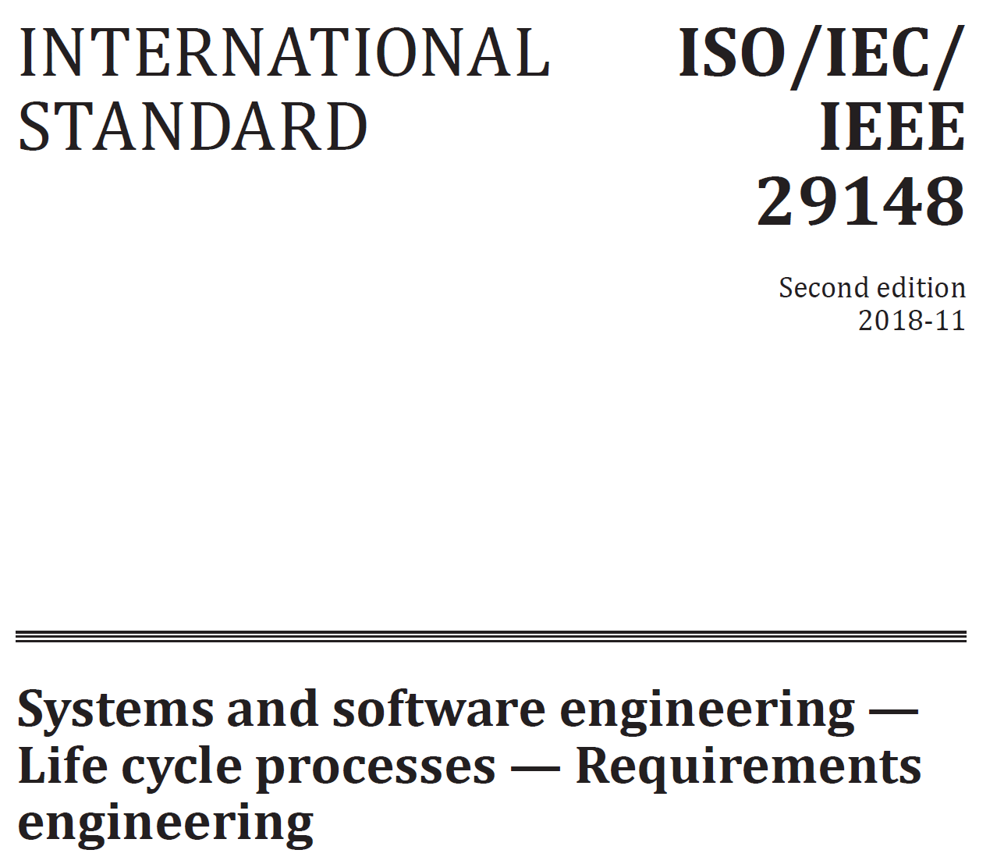
Testing Completeness
Are there any missing components?
Use a Requirements Specification Template as a baseline.
IEEE Std 830
ISO/IEC/IEEE 29148:2011(E)

Slide 7
Testing Traceability
To maintain traceability, you need to know which requirements belong to which product use cases, which business events are implemented with which business and product use cases, and so on.
To make sure it is traceable, each of your requirements must have the following characteristics:
A unique identifier.
An indicator of the type of requirement or constraint (we use the section number of the template in which the requirement appears).
References to all of the business use cases or product use cases that contain the requirement.
References to the stakeholder who is the originator of the requirement.
Consistent use of terminology.

Slide 8

Consistent Terminology
To specify a requirement so it is understood in only one way, you should define the terms you are using and the meanings of those terms within the specification.

Slide 9
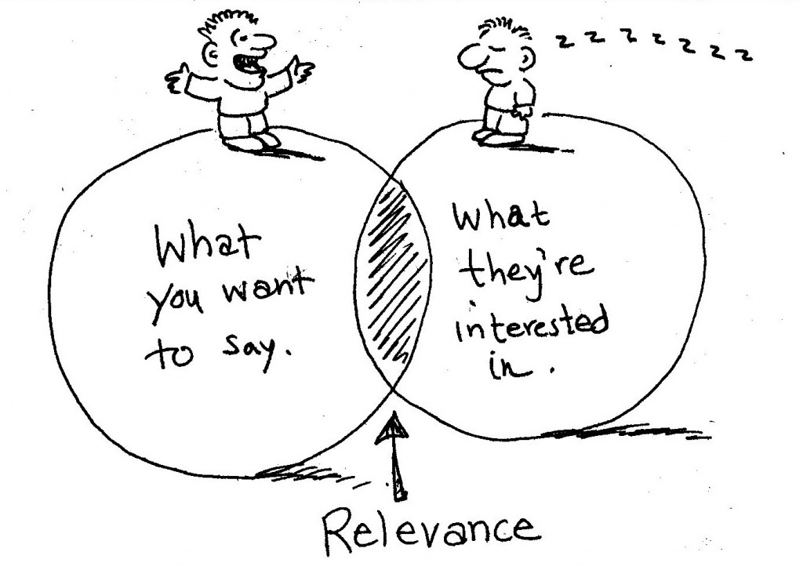
Relevant to Purpose?
To test a requirement for relevancy, compare its intention with the project goals.
Does this requirement contribute to the purpose of the project?

Slide 10
Testing the Fit Criterion
The fit criterion is a quantification of the requirement, which, as far as possible, uses numbers (numbers have no ambiguity) instead of words to express the requirement.
Does each requirement have a fit criterion that can be used to test whether a solution meets the requirement?
Example:
Description: The product shall appear easy to use.
Rationale: The client needs the users to voluntarily and quickly adopt it.
Fit Criterion: First-time users shall hesitate no more than ten seconds before starting to use the product. The number of people refusing to use the product shall be fewer than 15 percent.

Slide 11
Correctness
An SRS is correct if, and only if, every requirement stated therein is one that the software shall meet.
There is no tool or procedure that ensures correctness.
The SRS should be compared with any applicable superior specification, such as a system requirements specification, with other project documentation, and with other applicable standards, to ensure that it agrees.
Alternatively the customer or user can determine if the SRS correctly reflects the actual needs.
Traceability makes this procedure easier and less prone to error.

Slide 12
Conflicting Requirements
Two requirements are conflicting if you cannot implement them both—the solution to one requirement prohibits implementing the other.
For example, if one requirement asks for the product to “be available to all” and another says it shall be “fully secure,” then both requirements cannot be implemented as specified.
For functional requirements, look for conflicts in outcomes.
Conflicts between requirements are normal for most requirements gathering efforts, and indicate the need for some sort of conflict resolution mechanism.
When you have isolated the conflicting requirements, approach each of the stakeholders separately. Go over the requirement with the user and ensure that both of you have the same understanding of it. Reassess the satisfaction and dissatisfaction ratings: If one stakeholder gives low marks to the requirement, then he may not care if you drop it in favor of the other requirement. Do this with both stakeholders and do not, for the moment, bring them together.

Slide 13
IEEE Std 830
An SRS should be
Correct;
Unambiguous;
Complete;
Consistent;
Ranked for importance and/or stability;
Verifiable;
Modifiable;
Traceable.

Slide 14
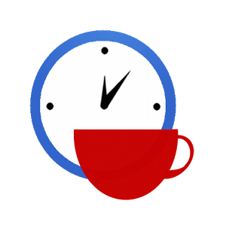

Slide 15
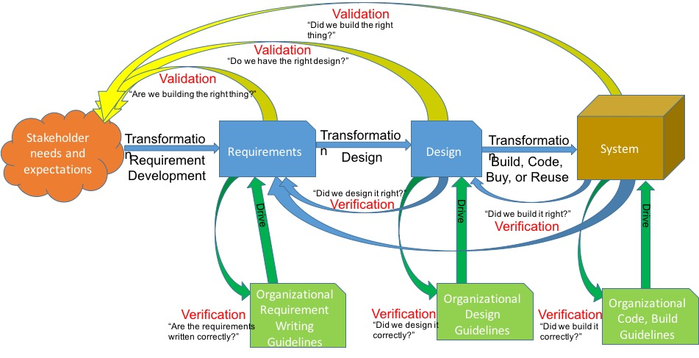
Verification vs. Validation

Slide 16

Requirements Verification
Check that product is being built right.
Ensures that each step followed in the process of building the software yields the right products
Checks consistency of the software requirements specification artifacts and other software development products (design, implementation, test) against the specification.

Slide 17

Requirements Validation
Check that the right product is being built.
Ensures that the software being developed (or changed) will satisfy its stakeholders.
Checks the software requirements specification against stakeholders goals and requirements.

Slide 18
Why and When?
Help ensure delivery of what the client wants.
Need to be performed at every stage during the (requirements) process
Elicitation
Checking back with the elicitation sources
“So, are you saying that . . . . . ?”
Analysis
Checking that the domain description and requirements are correct
Specification
Checking that the defined system requirement will meet the user requirements under the assumptions of the domain/environment
Checking conformity to well-formedness rules, standards.

Slide 19

Requirements V&V Techniques
Simple checks
Traceability, well-written requirements
Prototyping
Functional test design (Test cases)
User manual development
Reviews and inspections
Walkthroughs, formal inspections, checklists
Model-Based V&V (Model validation)
First-order logic, behavioral models

Slide 20
Lessons Learned
https://huybien.com/software-requirements-lessons-learned/

Slide 21

Thank You & See You Again

